Slide 1
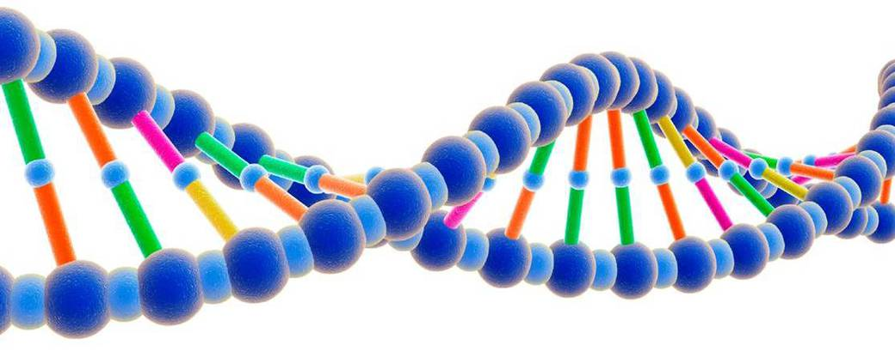

Faith Is Reasonable

Slide 2
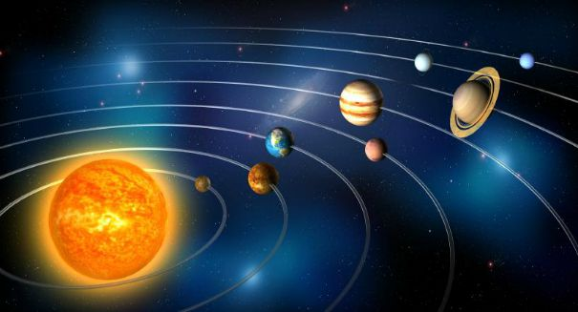
External Evidences
Psalm 19:1-4; Acts 14:14-17; Romans 1:20-21
The order found in the universe.
We understand cause and effect.
Does order require someone to put it in order or can random forces bring order?

Slide 3
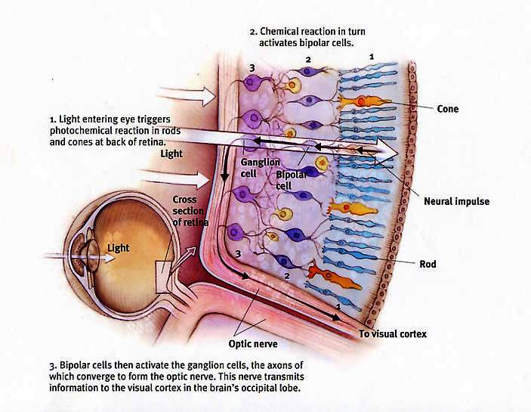
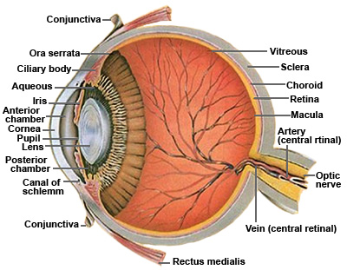
External Evidences
Complexity argues against an unguided arrangement.
Bacterial flagella.
The human eye.
Genesis 1:31

Slide 4
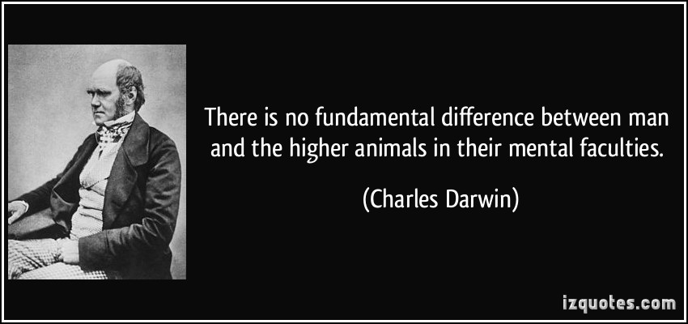
External Evidences
Genesis 1:26-27; 9:6
Animals act on instinct, while people have moral codes of conduct.
Where do atheistic ethics originate?
Some are critical of the God of the Bible, but by what standard?

Slide 5
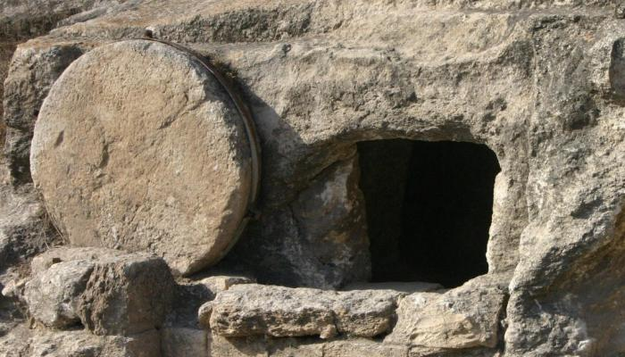
Internal Evidence: Jesus’ Resurrection
He endorsed the Genesis creation. Matt. 19:3-6; Mark 10:5-9
If He was who He claimed to be, then His claims about creation are validated.

Slide 6
Internal Evidence: Jesus’ Resurrection
Promised the resurrection as a sign. Matt. 12:38-40; 16:21; 17:22-23; John 10:17-18
Were the claims validated? Romans 1:1-4
Eyewitnesses said yes. 1 Cor. 15:1-8
The apostles were transformed.
Two skeptics were convinced.
  Thomas. John 20:24-29;
  Paul. 1 Tim. 1:12-13; Gal. 1:13-16; 1 Cor. 15:8

Slide 7
Conclusion
Much more could be said.
  Mind Your Faith, Doy Moyer
  Buddy Payne, Jones Road website
But this should be enough to give faith a chance. Rom. 10:17
Do you have faith? Faith to diligently seek Him?

